Slide 1
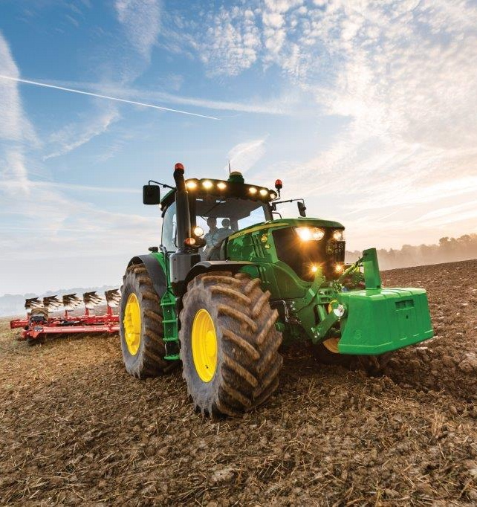











Open Call #1 Co-creation kick-off
Web meeting 07-04-2020
Miguel Gonçalves, F6S
Building an Interoperable, Data-Driven, Innovative & Sustainable European Agri-Food Sector

Slide 2



Table of content
Overall open call goals
Main characteristics
Roles
Timeline
Documents
Eligibility (Who? What?)
Evaluation criteria
Diagram
Monitoring
Identification of evaluators
Discussion
Next steps

Slide 3
Overall open call goals
Enable the extension of the DEMETER’s technology offer beyond consortium partners and enlarge the outreach of the large-scale pilots by supporting the deployment of new pilots in different geographic regions through two open calls

Slide 4
Open Call Goals
OPEN CALL #1 – DEVELOP:
Enlarge pool of Agro-interoperable technologies by engaging tech SMEs towards the integration of their solutions
(Opening: M12 – August 2020)
OPEN CALL #2 – DEPLOY:
Deploy geographic distributed small-scale pilots that demonstrate the impact and potential of DEMETER approach towards digitalising and boosting European Agro-business.
(Opening: M22 – June 2021)

Slide 5

Open Call #1 – DEVELOP: Main characteristics
Objective:
to attract and fund single tech-SMEs (legal entities under the EC regulations) in the development, integration and interoperability of technological products/ services within DEMETER ecosystem.
Main call characteristics:
total budget: €300k;
budget per project: up to €30k (equity-free);
number of funded projects: 8-12;
duration of the project: 6-months.
attract a minimum of 60 proposals
Cascade funding

Slide 6



Open Call #1 – DEVELOP: Roles
All DEMETER partners
Open Call Manager
handling OC procedures via T7.3
supported by WP7 members
+ dissemination
Coordinator
handling OC administration & funding via WP1
+ dissemination
Dissemination Lead
coordinating WP6
dissemination
+ contracts are signed on behalf of the consortium
+ dissemination
Project Management Board

Slide 7
Open Call #1 – DEVELOP: Timeline
Project month | Month/year | Deliverable/Task/Milestone
M07 | March 2020 | F6S starts working on open call documents
M08 | April 2020 | Open call co-creation process
M09 | May 2020 | Open call documents are released from WP7 to Project Management Board to review
M10 | June 2020 | Open call documents are approved internally and sent to the PO for approval
M11 | July 2020 | Submit deliverable D7.2 Open Call Handbook and request to officially open the call
M12 | August 2020 | Open call launch
M14 | September 2020 | Open call closure
M16 | November 2020 | Evaluation Sign sub-grant agreements
M16 | November 2020 | Selected-projects start - Milestone MS4
M22 | May 2021 | End of project’s execution

Slide 8
Open Call #1 – DEVELOP: Documents
Open Call Text
Guidelines for applicants
Proposal template / Application Form
+proposal supplement
FAQ
Honour Declaration
SME Declaration
Bank account information
Sub-grantee agreement template
Template for H2020 Financial Support to Third Parties

Slide 9
Open Call #1 – DEVELOP: Documents
Open Call Handbook (D7.2)
Open Call Text
Guidelines for applicants
Proposal template / Application Form
+proposal supplement
FAQ
Honour Declaration
SME Declaration
Bank account information
Sub-grantee agreement template
Template for H2020 Financial Support to Third Parties

Slide 10
Open Call #1 – DEVELOP: Eligibility
Who? (do we want to fund)
What we know:
Single tech-SMEs (legal entities under the EC definition of SMEs)
Established in an EU Member State or Associated Country
Working in the development, integration and interoperability of technological products/ services applicable in the agri-food sector.
To avoid conflicts of interest, applications will not be accepted from persons or organisations who are partners in the DEMETER consortium or formally linked in any way to partners of the consortium. Applicants will be required to declare that they know of no such potential conflicts of interest that should prevent them from applying.
What we don’t know:
Specific team skills or/and composition?
Do we want add other restrictions?
Not previously funded by other public funds,
Other kinds of conflict of interest. Max. No. of applications allowed per SME…

Slide 11
Open Call #1 – DEVELOP: Eligibility
What? (do we want to fund)
What we know:
Agro-interoperable technologies to integrate within DEMETER ecosystem
Reshaping third parties technologies in order to integrate and make them interoperable with DEMETER platform
What we don’t know:
Where do we want to be in the open call spectrum? From wide open, to extremely objective.
Openness
Closeness
Any technology aligned with DEMETER’s goals
Technologies within a certain subdomain
Technologies to solve specific challenges
Technologies for a specific Pilot need
Specific technologies

Slide 12
Open Call #1 – DEVELOP: Eligibility
What? (do we want to fund)
What we know:
Agro-interoperable technologies to integrate within DEMETER ecosystem
Reshaping third parties technologies in order to integrate and make them interoperable with DEMETER platform
What we don’t know:
Where we want to be in the open call spectrum? From wide open, to extremely objective.
Technology readiness level needed
Use of open source, open standards, etc.
Use of specific programming language,
Ethics requirements,
Security requirements,
Geographical requirements,
Data management requirements, Intellectual Property Rights management, …

Slide 13
Open Call #1 – DEVELOP: Evaluation criteria of applications
What we know:
Each proposal is scored based on:
Alignment - Projects must align with one or more of the supported activity categories defined above.
Excellence - Projects must demonstrate a clear set of objectives aligned with the definition of the DEMETER open call and with the general objectives of the project.
Impact: Applicants must define a clear set of deliverables aligned with the objectives of the open call. Proposals must demonstrate impact on the DEMETER ecosystem and its contribution to meeting the overall project objectives.
Value: Proposals must also include a clear budget, detailing the overall project cost, the amount of funding requested and how it will be spent. This budget must represent good value for money in the opinion of the evaluation panel selected to evaluate the open call applications.
What we don’t know:
Relevant subsections for any of the criteria

Slide 14
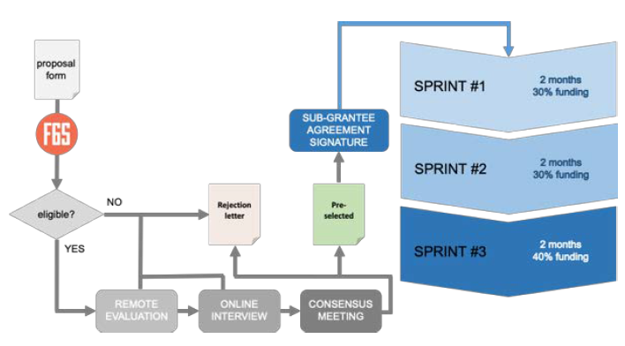
Open Call #1 – DEVELOP: Diagram

Slide 15
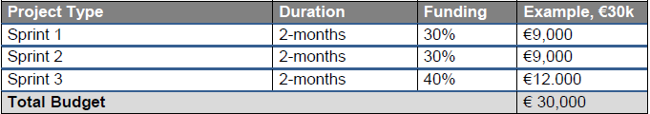
Open Call #1 – DEVELOP: Monitoring
What we know:
Milestones/ payments: sprints of 2-months with evaluation of sprint results. Payments are associated with respective results and divided by 30% + 30% + 40% (lumpsum base, based on deliverables and outcomes).
Evaluation: meeting with DEMETER assigned person (depending on the technology expertise required to evaluate results) at the end of each sprint.
What we don’t know:
The deliverables and outcomes definitions for each sprint,
The definition of the DEMETER assigned person to evaluate each third party,
The description of the support to offer to third parties in order to ensure integration and interoperability with DEMETER platform. (Monitoring, training, coaching, …)

Slide 16
Open Call #1 – DEVELOP: Identification of evaluators
What we know:
Proposals have to be reviewed by at least 2 external experts who are independent of the organisations involved in the DEMETER consortium and of any proposer.
The experts will be individuals from the fields of agriculture, science, industry and/or with experience in the field of innovation and also with the highest level of knowledge, and who are recognised authorities in the relevant specialist area.
Recommendations:
No. applications goal = 60 --> 6-8 evaluators.
DEMETER’s partners will be invited to suggest evaluators. F6S will collect expressions of interest from the potential evaluators.
a) At least 70% from the industry and business environment (from which at least 30% will represent the technology adopter perspective),
b) at least 40% women,
c) at least 10 years industrial experience,
d) experience evaluating proposals for the EC.
What we don’t know:
Who within DEMETER will assess the evaluators (small group)

Slide 17
Open Call #1 – DEVELOP: Discussion
Topics:
Timeline: Is the timeline adequate for the project goals and to cope with coronavirus impact?
Eligibility (who):
Do we need to specify team skills or/and composition?
Do we want add other restrictions?
Not previously funded by other public funds,
Other kinds of conflict of interest.
Max. No. of applications allowed per SME…
Eligibility (what):
Where we want to be in the open call spectrum?
Is it necessary to define:
A Technology readiness level?
The use of open source, open standards, etc.
The use of specific programming language,
Any ethic requirement,
Any security requirement,
Any geographical requirement,
Any data management requirement,
Any Intellectual Property Right condition

Slide 18
Open Call #1 – DEVELOP: Discussion
Topics:
Evaluation criteria of applications:
What relevant subsections of the criteria should be defined
Monitoring:
What are the deliverables and outcomes for each sprint?
Who should be the DEMETER assigned person to evaluate each third party?
What is the description of the support to offer to third parties in order to ensure integration and interoperability with DEMETER platform. (Monitoring, training, coaching, …)?
Call for evaluators
Who within DEMETER will assess the evaluators?

Slide 19
Open Call #1 – DEVELOP: Next steps
Send form to PMB and Clusters leaders members to collect information about technology needs – Today
Answers by May 7th ?
Results analysis
New PMB meeting to present and discuss results May 14th?

Slide 20
Thank you!
Questions?
Miguel Gonçalves
miguel@f6s.com

